Slide 1
Sales Performance Evaluation and Managerial Impact Analysis across U.S. Cities
Using EXCEL
BY
Adebayo Abdulmalik

Slide 2
Introduction
In today’s competitive retail environment, understanding what drives sales performance across different cities, products, and time periods is crucial
This project analyzes regional sales data to understand how different products, customer demand, and sales management influence total revenue across cities in the U.S. It combines transactional data on sales with management control for purposes of examining trends, top-performing areas, and sales strategies. The objective is to evaluate sales management, assess sales trends, present data-based insights for the purpose of improving the efficiency of sales, product targeting, and decision-making

Slide 3
Data Collection Process
The data was collected from two internal sources:
Dataset 1: Transactional sales data including Order ID, Product, Quantity, Unit Price, Customer, Location, and Date of Sale.
Dataset 2: Mapping of Cities to Sales Managers for regional performance analysis.
Time-based fields such as Week, Month and Year of Sale were generated for trend analysis.

Slide 4
OBJECTIVES
ANALYZE Product Demand and Profitability:
Analyze which products generate the highest sales volume and revenue. done
Track product performance over time.
Sales Manager Impact Analysis:
Link cities to sales managers and compare performance under different managers.
Identify managerial styles or strategies correlating with high sales.
Weekly Sales Trend Analysis
Analyze how sales fluctuate week by week.
Sales Seasonality Detection
Identify seasonal patterns:
When do sales spike (e.g., holidays)
(Helps with inventory planning and marketing timing.)

Slide 5
Data Cleaning and Transformation Process
Check for and handle missing values, duplicates, or invalid data.
Standardize column formats (e.g., dates, numbers).
Format the unit price and total sales column into currency ($) with 2 decimal places
Extracted Week of Sale and Year of Sale from transaction dates.
Merged Dataset 1 and 2 using the City field to associate sales with managers.
Standardized date formats and corrected inconsistent product labels.

Slide 6
Data Modelling Process
Built calculated fields (e.g., Total Sales = Quantity × Unit Price)
Using a lookup function referencing the data in DATASET 2, created a column named "Sales Manager"
Created Pivot Tables to model:
Total Sales by City, Product, and Managers
Weekly contribution to annual sales
Manager-wise performance
Product demands and products performance
Analyze how sales fluctuate
Identify best selling periods
Highest buying Customer

Slide 7
Data Analysis
Identified top-performing products and cities.
Tracked weekly, monthly and yearly sales patterns.
Measured customer frequency, identifying repeat vs. one-time buyers.
Compared sales performance across different managers and cities.
Identify top performing mangers at the end of the year

Slide 8
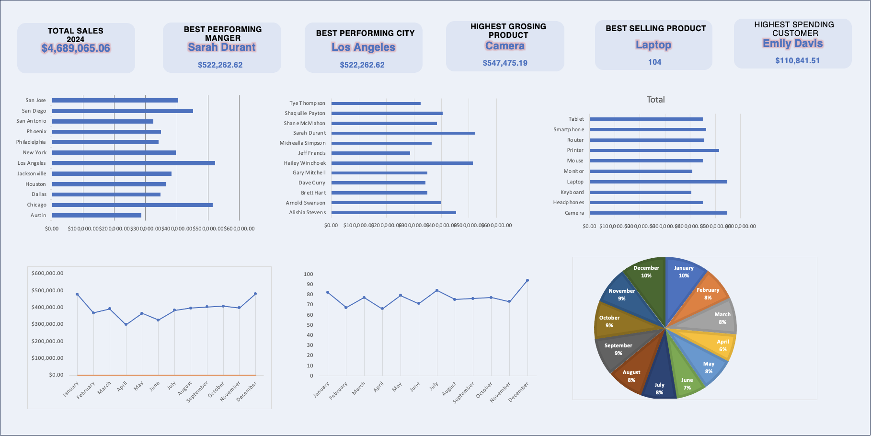

Slide 9
Key Insights
CERTAIN WEEKS (E.G., WEEK 1-5, 37-39, 49-51) SHOW CONSISTENT SALES SPIKES.
SALES ARE PRETTY HIGH DURING THE HOLIDAYS (BEGINNING OF THE YEAR, END OF THE YEAR AND SUMMER HOLIDAYS)
LAPTOP, CAMERA AND PRINTER ACCOUNT FOR OVER 30% OF ANNUAL REVENUE.
AUSTIN COULDN’T OUTPERFORM LOS ANGELES DESPITE HAVING HIGHEST NUMBER OF CUSTOMERS.
SARAH DURANT CONSISTENTLY DELIVERS HIGHER SALES.
REPEAT CUSTOMERS TEND TO BUY WITHIN 4-WEEK INTERVALS.

Slide 10
Recommendations
TARGET HIGH-PERFORMING WEEKS FOR MAJOR PROMOTIONS AND LAUNCHES.
INVEST IN BEST-SELLING PRODUCTS’ INVENTORY DURING HIGH-DEMAND PERIODS.
ALSO TARGET HOLIDAY PERIODS (WHICH SEEM TO BE THE HIGHEST SELLING PERIODS) WITH PROMOTIONAL OFFERS
REWARD TOP-PERFORMING SALES MANAGERS IN OTHER TO INFLUENCE OTHER MANAGERS TO DO BETTER
REPLICATE STRATEGIES USED BY TOP-PERFORMING SALES MANAGERS.
REALIGN SALES STRATEGIES IN UNDERPERFORMING CITIES—REVIEW LOCAL MARKET CONDITIONS
ENCOURAGE LOYALTY PROGRAMS BY GIVING OUT GIFTS TO BEST CUSTOMERS TO INCREASE REPEAT CUSTOMER BEHAVIOR.

